Slide 1
Mid-term project for the course Distributed & Scalable Data Engineering (DSDE) - 6007-02
Group -5
Bharath Kondreddy
Rishith Rao Cheeti
Vishnu Vardhan Koganti
Indhiresh Reddy Lingareddy

Slide 2
Enterprise Data Warehouse for Blood Donations

Slide 3
Contents
Business Understanding
Data Understanding
Data Preparation
Problem
Solution
Tools & Technologies
Modeling
Evaluation
Deployment

Slide 4
Business Understanding
Client needs to have the data of the blood donations and information about the blood donors in the Data Warehouse.
Reasons for having the data in Data Warehouse are:
To plan the drives as per the business requirement.
For analysing the commercial aspects of the business.

Slide 5
Data Understanding
Dataset contains the following features
ID
Name
Age
Gender
Race
Date
City
State
Blood Group
Source: Kaggle

Slide 6
Data Preparation
Remove or redirect the records whose age and blood group columns are null values.

Slide 7
Problem
Receiving the source data in the form of csv files and those CSV files needs to cleanse to store in the Data Warehouse which is now happening using some ETL tools.
Effects of this process:
Time consuming
Lack of resources
Beyond the budget estimations

Slide 8
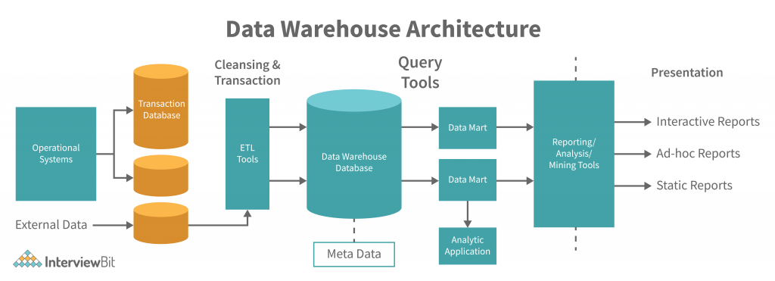
Solution
Automating the movement of received files from Data Lake to Data Warehouse

Slide 9
Tools And Technologies
Aws S3 - Amazon S3 or Amazon Simple Storage Service is a service offered by Amazon Web Services that provides object storage through a web service interface
AWS Lambda - AWS Lambda is an event-driven, serverless computing platform provided by Amazon as a part of Amazon Web Services
AWS Redshift - Amazon Redshift is a data warehouse product which forms part of the larger cloud-computing platform Amazon Web Services
Python 3.10
Pandas - Pandas is a software library written for the Python programming language for data manipulation and analysis
PowerBI- Power BI is an interactive data visualization software product developed by Microsoft with a primary focus on business intelligence

Slide 10
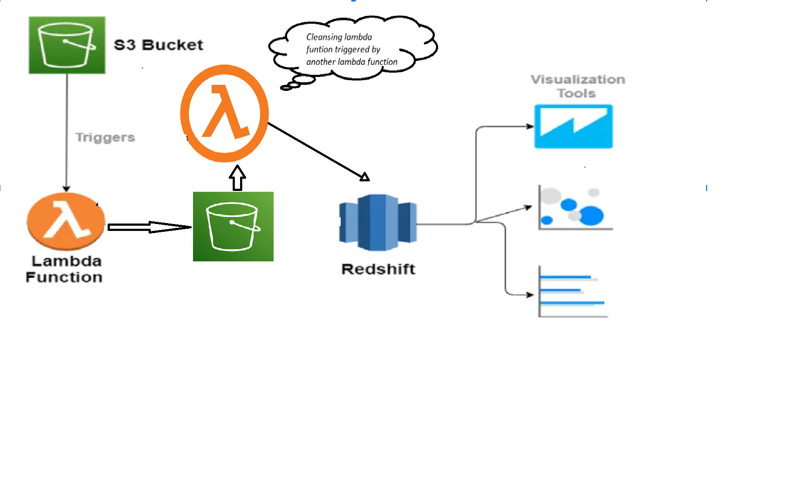
Modeling

Slide 11
Evaluation
CSV files will be received into s3 bucket from the source.
Lambda function triggers to cleanse and move the CSV data to Redshift.
During cleansing process some of the metrics will be taken from the received data.
Once Data is loaded into Redshift then BI(Business Intelligence) tools can be used to analysis the business.

Slide 12
Deployment
Step1: Create a new S3 bucket attach a lambda function to it
Step 2: Attach a Lambda function trigger to the created s3 bucket and Data cleansing will be
performed in this lambda function.
Step 3: Once data cleansing is done then a new csv file will be uploaded to destination bucket.
Step 4: Then another lambda function triggers which moves the data in the csv file to Redshift.
Step 5: Now the data is available in the Data Warehouse to built reports on top of it.

Slide 13
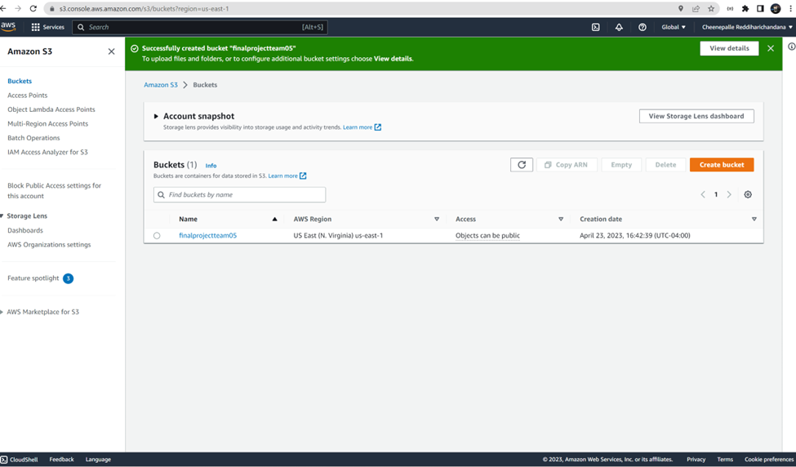
Step 1

Slide 14
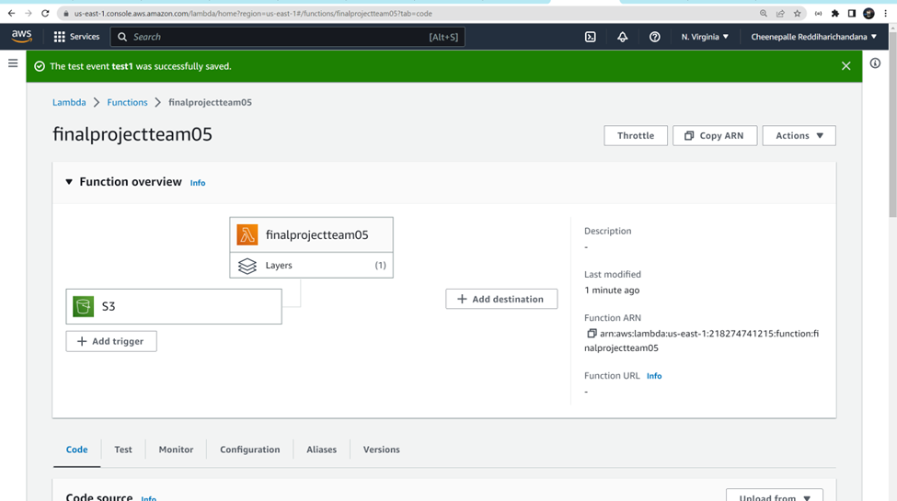
Step 2:
This Lambda function has Pandas package as a layer to clean the data.
It is attached as a trigger to the S3 bucket.

Slide 15
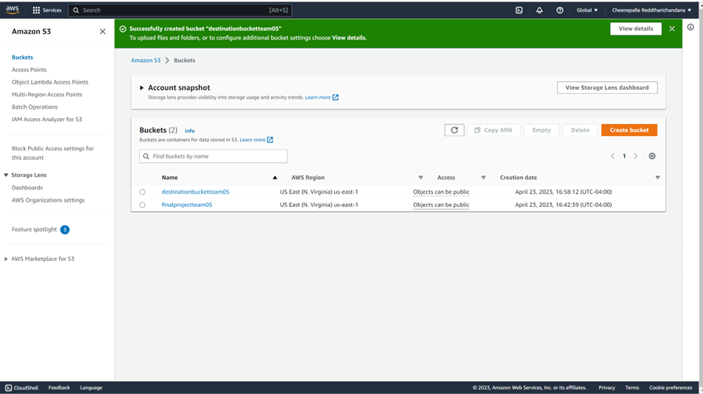
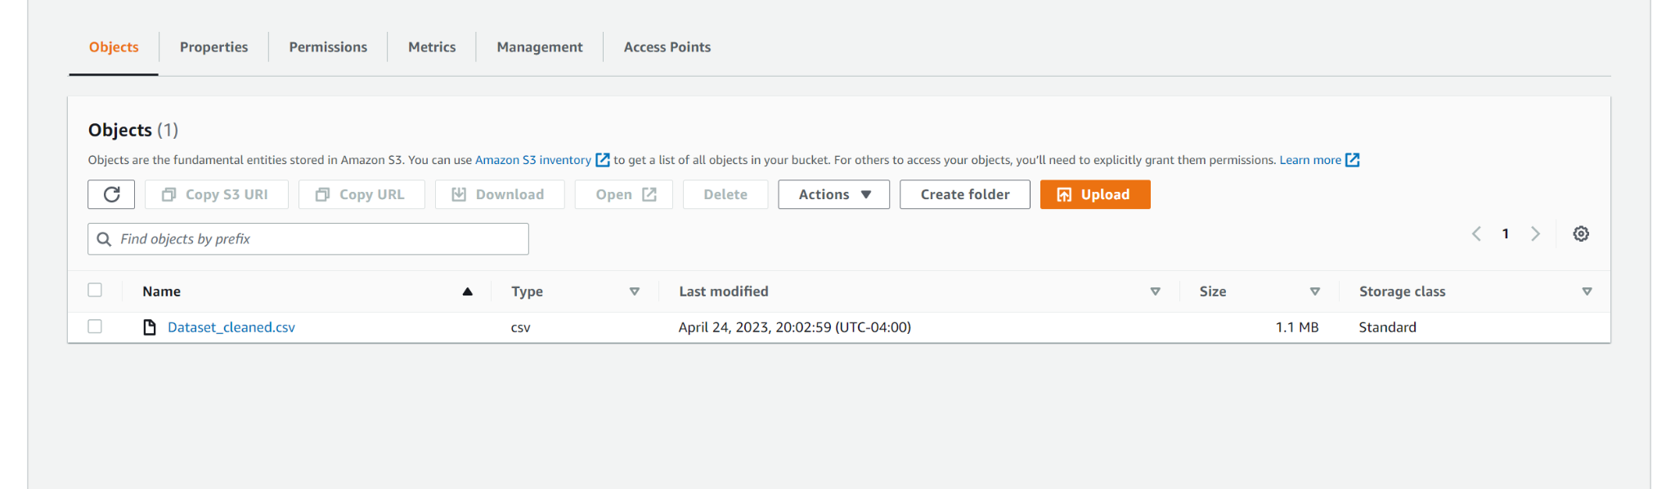
Step 3:

Slide 16
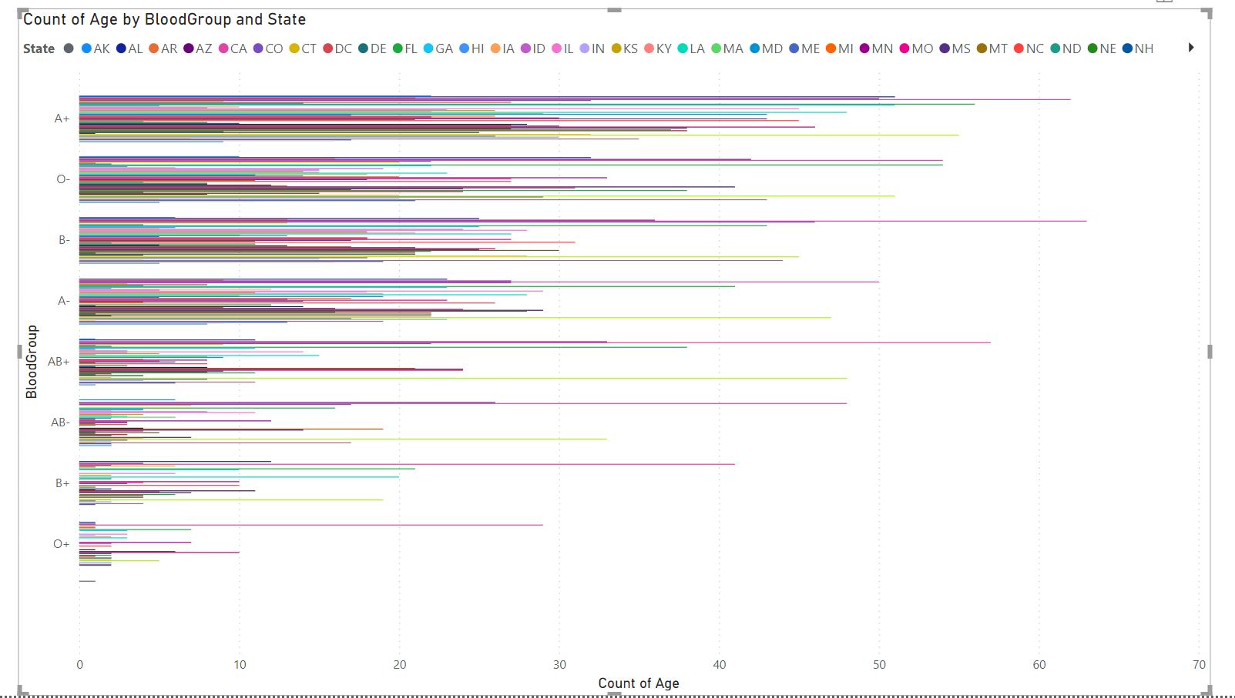
Step 5

Slide 17
Thank You

